Slide 1
Visualization of Volatility Surface and Swaption Market Monitor
Advisors: Dr. Ionut Florescu, Dr. Dragos Bozdog
Group Members: Zenghui Liu, Libo Duan, Kejia Huang

Slide 2
Project
1. Visualizing the local volatility for European options
2. Building a shiny-dashboard to monitor swaption market

Slide 3
Data
Implied Volatilities of S&P 500 Index:
Bloomberg
Date: 9/3/2013 to 12/30/2016
Time to Maturity: 1M to 24M
Strike: 80% Mny to 120% Mny
ATM USD Swaption and Forward Swap Rate:
Bloomberg
Date: 1/1/2016 to 1/1/2017
Expiry: 1M to 30Yr
Tenor: 1Yr to 30Yr

Slide 4
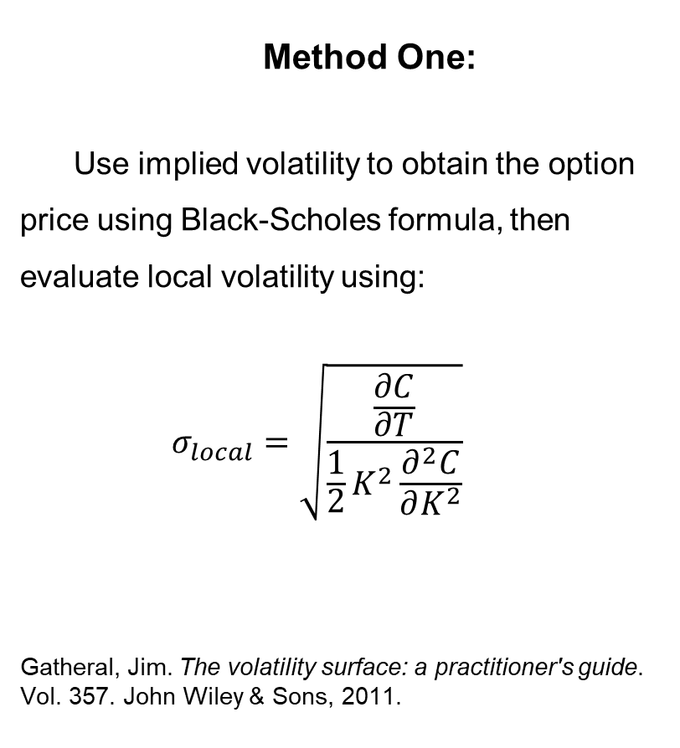
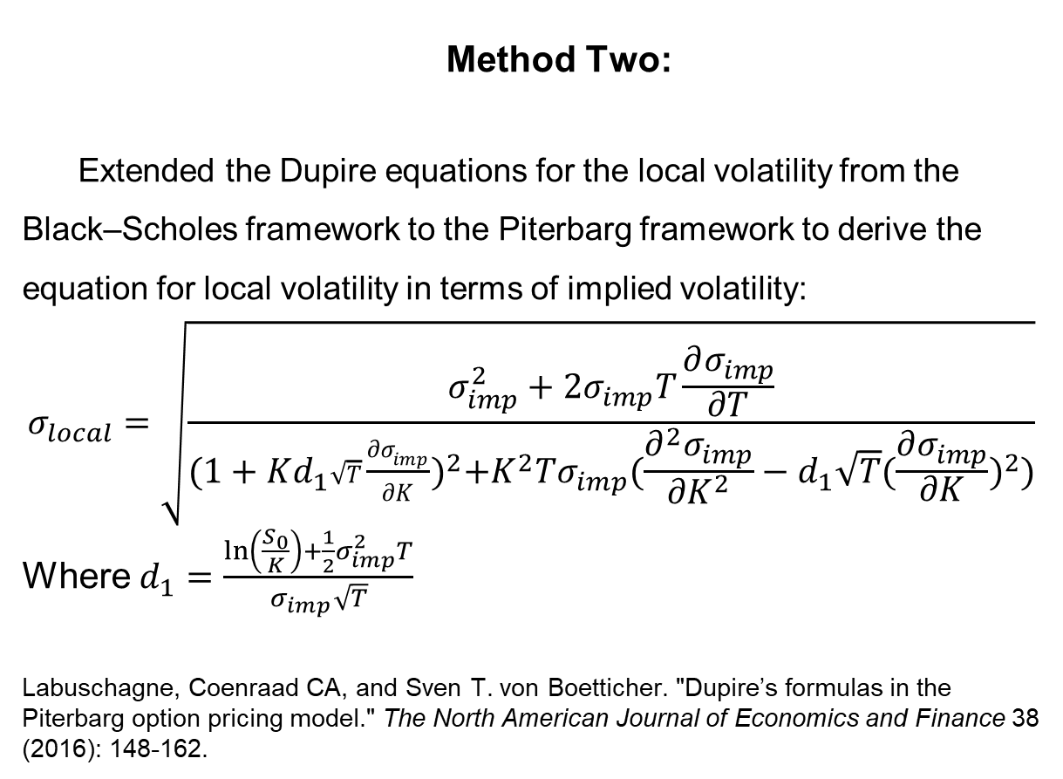
Local Volatility Surface Construction Method
Method One:
Use implied volatility to obtain the option price using Black-Scholes formula, then evaluate local volatility using:
$$σ_{local}=\sqrt{\frac{\frac{∂C}{∂T}}{\frac{1}{2}K^{2}\frac{∂^{2}C}{∂K^{2}}}}$$
Gatheral, Jim. The volatility surface: a practitioner's guide. Vol. 357. John Wiley & Sons, 2011.
Method Two:
Extended the Dupire equations for the local volatility from the Black–Scholes framework to the Piterbarg framework to derive the equation for local volatility in terms of implied volatility:
$$σ_{local}=\sqrt{\frac{σ_{imp}^{2}+2σ_{imp}T\frac{∂σ_{imp}}{∂T}}{{(1+Kd_{1}\sqrt{T}\frac{{∂σ}_{imp}}{∂K})}^{2}+K^{2}Tσ_{imp}(\frac{∂^{2}σ_{imp}}{∂K^{2}}−d_{1}\sqrt{T}{(\frac{∂σ_{imp}}{∂K})}^{2})}}$$
Where $d_{1}=\frac{\ln\left(\frac{S_{0}}{K}\right)+\frac{1}{2}σ_{imp}^{2}T}{σ_{imp}\sqrt{T}}$
Labuschagne, Coenraad CA, and Sven T. von Boetticher. "Dupire’s formulas in the Piterbarg option pricing model." The North American Journal of Economics and Finance 38 (2016): 148-162.

Slide 5
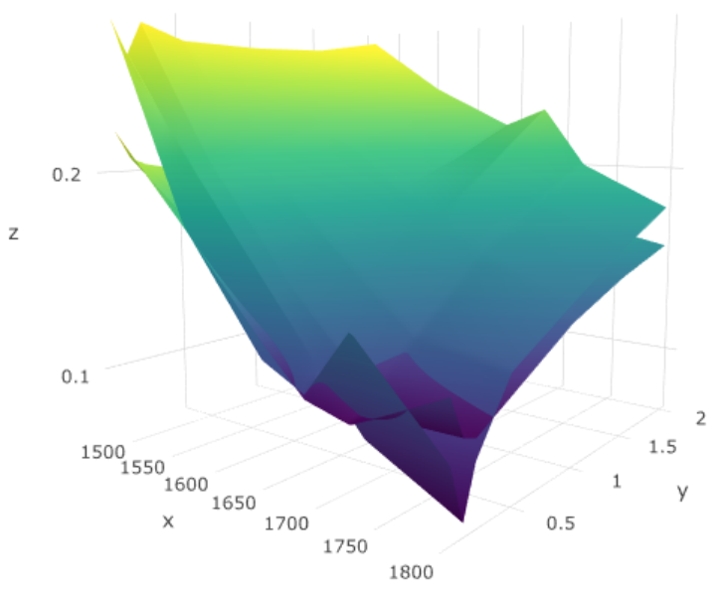
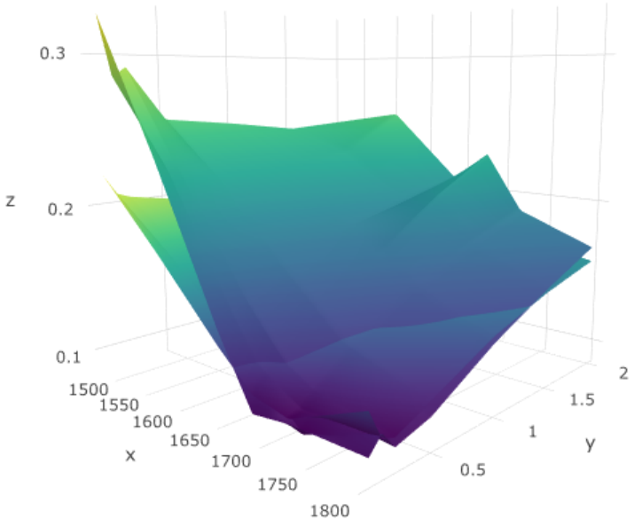
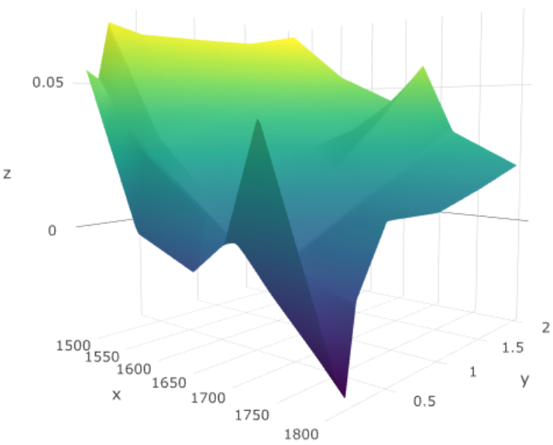
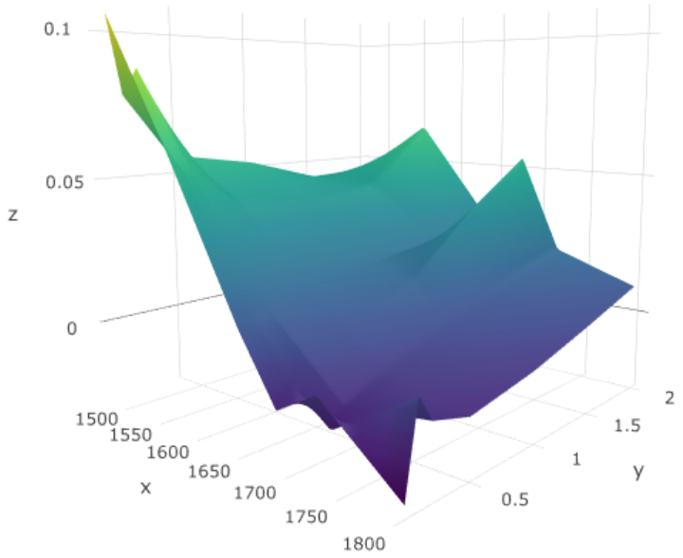
Local Volatility: Results and Visualizations
Method One:
Method Two:
Local Volatility
Implied Volatility
Differences between local volatility surface and implied volatility surface

Slide 6
Local Volatility: Result Discussion
Method One:
Method Two:
Error: 5.66% 3.70%
Notes:
Use implied volatility data only for Strike Price: 95% Mny to 105%
Split data in two datasets: for each day’s volatility surface, three points in different Strike and expiry into one dataset and the rest into another dataset
Use the dataset without three points to compute local volatility surface using both methods
Compute the option price using the local volatility results on that three locations
Compare with the actual option price and find average error

Slide 7
Market Monitor
Use data to
calibrate model
Obtain 30 days model volatilities
Choose date
Load previous 30 days data
Exercise trading strategy
Compare the chosen date quote volatilities with confidence interval
Calculate model volatility confidence interval
Load market data of the next day Calculate profit and return
Visualize results

Slide 8
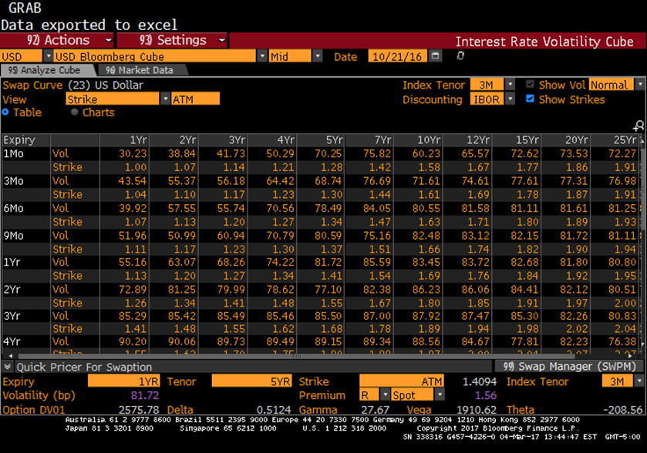
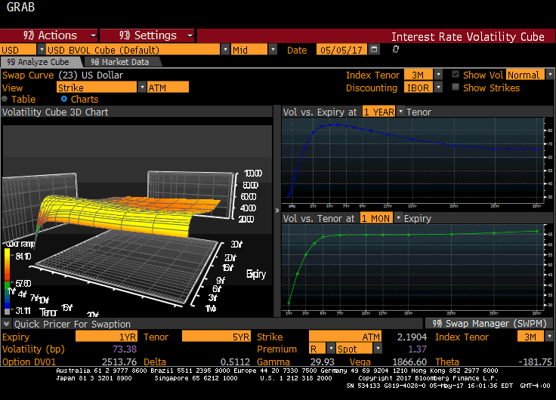
Single Day data in Bloomberg VCUB

Slide 9
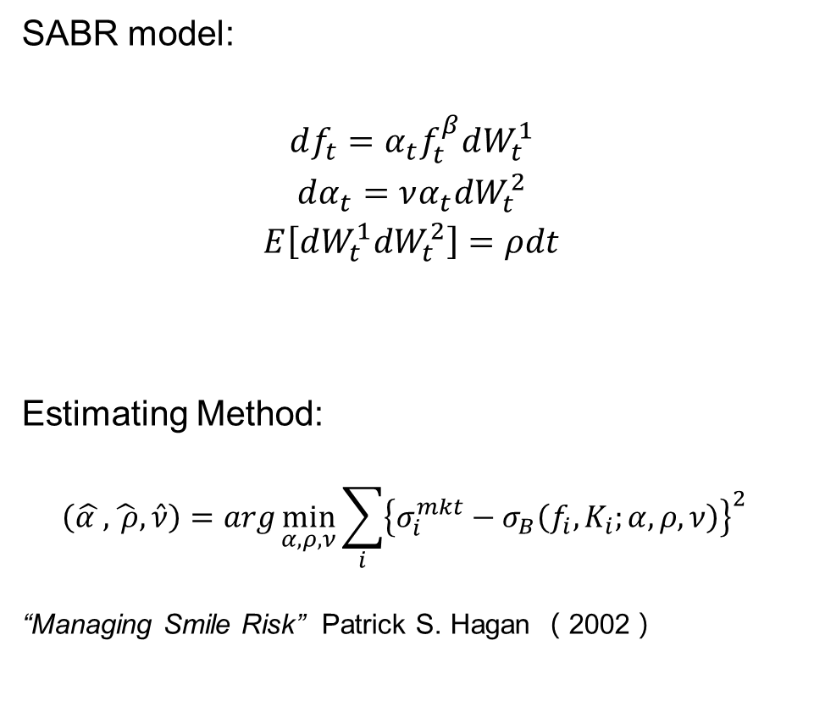
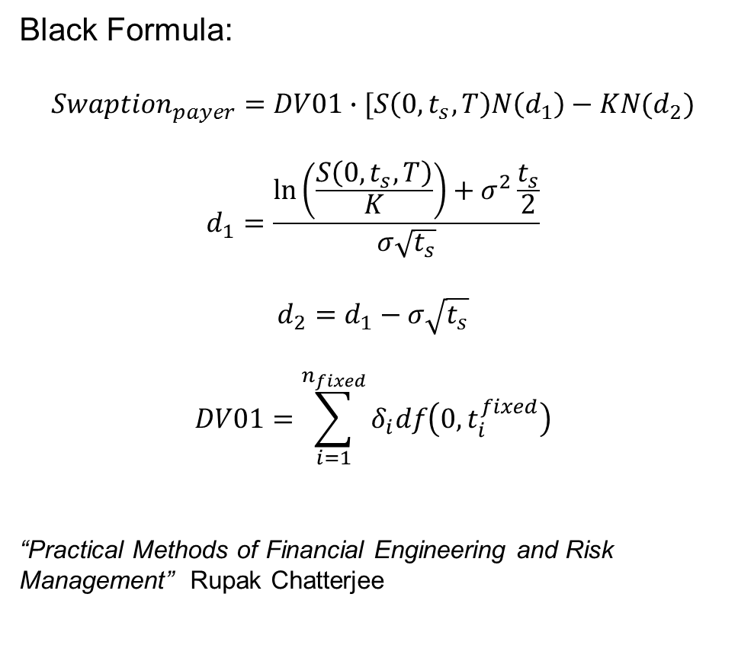
Implied Volatility: Methodology
SABR model:
$$df_{t}=α_{t}f_{t}^{β}dW_{t}^{1}$$
$$dα_{t}=να_{t}dW_{t}^{2}$$
$$E\left[dW_{t}^{1}dW_{t}^{2}\right]=ρdt$$
Estimating Method:
$$\left(\hat{α },\hat{ ρ},\hat{ν}\right)=arg\min_{α,ρ,ν}{\sum_{i}{{\left\{σ_{i}^{mkt}−σ_{B}\left(f_{i},K_{i};α,ρ,ν\right)\right\}}^{2}}}$$
“Managing Smile Risk” Patrick S. Hagan （2002）
Black Formula:
$$Swaption_{payer}=DV01∙[S\left(0,t_{s},T\right)N\left(d_{1}\right)−KN(d_{2})$$
$$d_{1}=\frac{\ln\left(\frac{S\left(0,t_{s},T\right)}{K}\right)+σ^{2}\frac{t_{s}}{2}}{σ\sqrt{t_{s}}}$$
$$d_{2}=d_{1}−σ\sqrt{t_{s}}$$
$$DV01=\sum_{i=1}^{n_{fixed}}{δ_{i}df\left(0,t_{i}^{fixed}\right)}$$
“Practical Methods of Financial Engineering and Risk Management” Rupak Chatterjee

Slide 10
SABR Monitor
http://fevl02.fsc.stevens.edu:3838/users/fe800/version%20final/

Slide 11
Thank you
Questions?

